Slide 1

MODY UNIVERSITY OF SCIENCE AND TECHNOLOGY
SCHOOL OF ENGINEERING AND TECHNOLOGY
PROGRAMMING LANGUAGE C++ (CS-16.104)
PROJECT BASED LEARNING-PHASE Il
SUBMITTED TO – Dr. Prateek Bhanti
SUBMITTED BY-
NIDHI CHOUDHARY
HARSHITA GARG
HIRAL JAIN
AKSHITA KANTHER
SIMRAN JAIN

Slide 2
HOTEL MANAGEMENT SYSTEM
HOTEL MANAGEMENT SYSTEM

Slide 3

CONTENTS
INTRODUCTION
INTRODUCTION TO C++
FEATURES OF C++
APPLICATIONS OF C++
WHY HOTEL MANAGEMENT
DESCRIPTION
CONCEPT USED

Slide 4
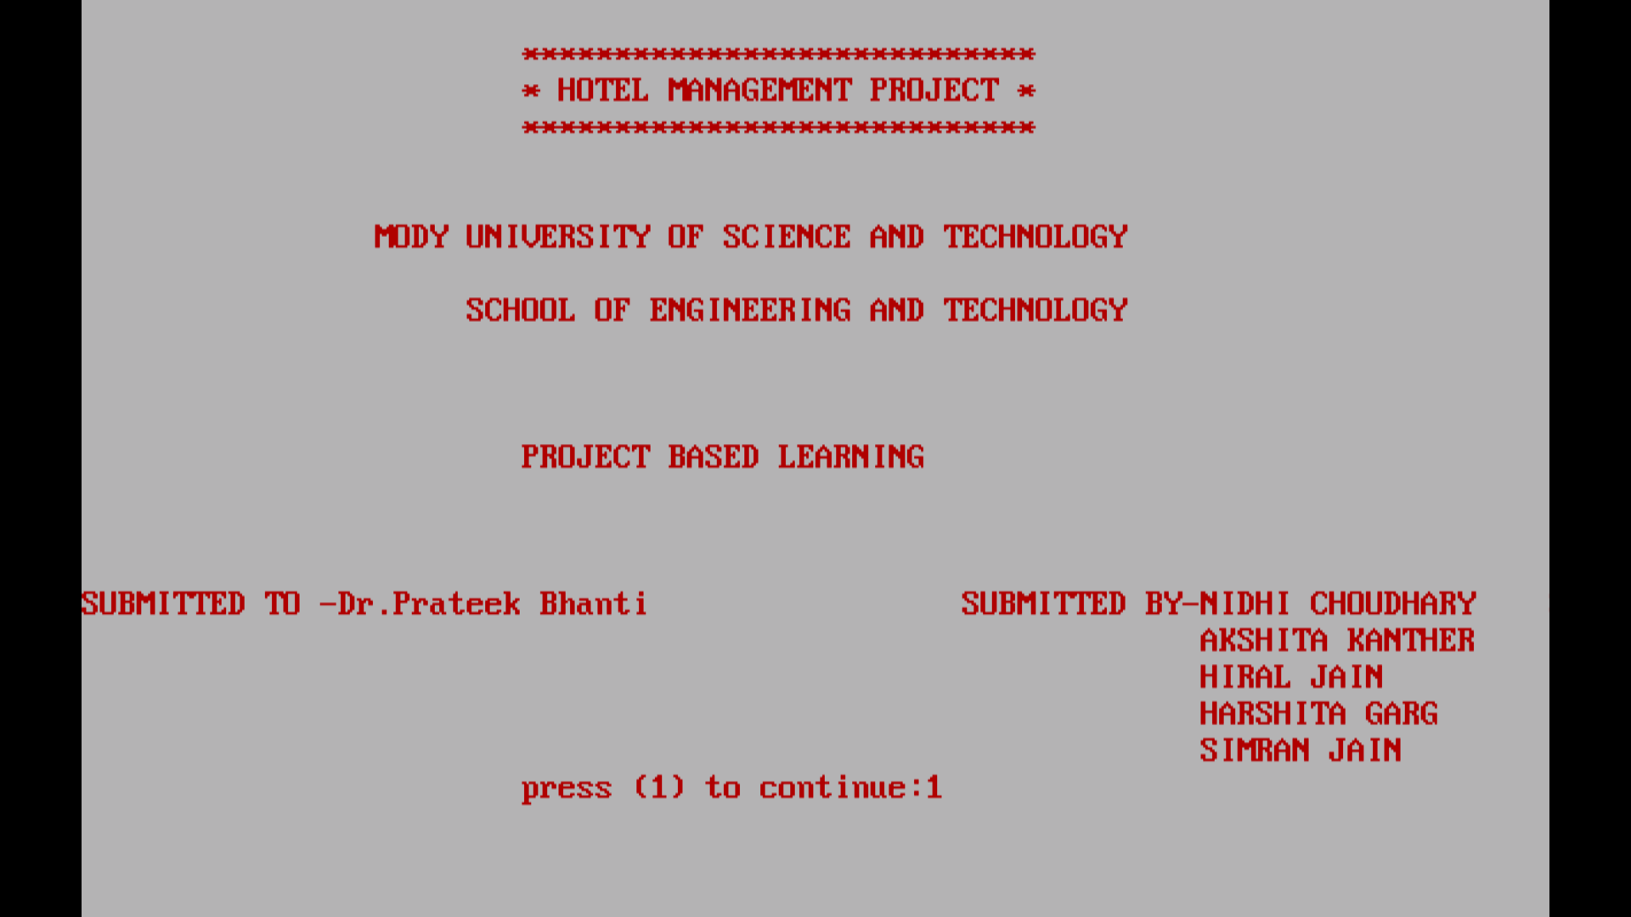
INTRODUCTION
This hotel management system has been developed to meet all the processing requirements which are needed within the hotel industry . This system will allow to manage the records of the customer and their payment in easy manner .To use this system , it’s users should have a valid password . Once the correct password will be entered, verification process will be taken place at the backend side and if entered password will be correct , admin will be redirected to the next section.

Slide 5

LANGUAGE USED:

Slide 6
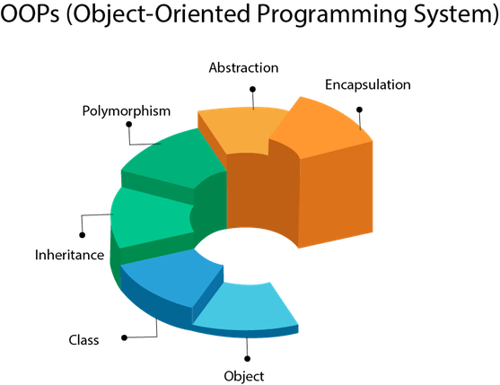
Introduction to C++
C++ is an object oriented programming language developed by Bjarne Stroustrup at AT&T Bell Laboratories in the early 1980s. Earlier it’s name was “C with classes”. However ,in 1983,Rick Mascitti coined the term C++.
Need of C++
To build a complex software , it is not just enough to put a sequence of statements and set of procedures and modules , we need to incorporate sound construction techniques and structures that are easy to implement and modify.
OBJECT-ORIENTED PROGRAMMING-
It is an approach that provides a way of modularising the program by creating partition memory area for both data and function that can be used as template for creating copies of such modules on demand. Few of the features of OOPs are listed below:
Features of OOP’s

Slide 7
Features of C++

Slide 8

GRAPHICal USER INTERFACE(GUI)
OPERATING SYSTEMS
REAL WORLD APPLICATIONS
OF C++
MEDICAL APPPLICATIONS
COMPILERS
DATABASE SOFTWARE

Slide 9
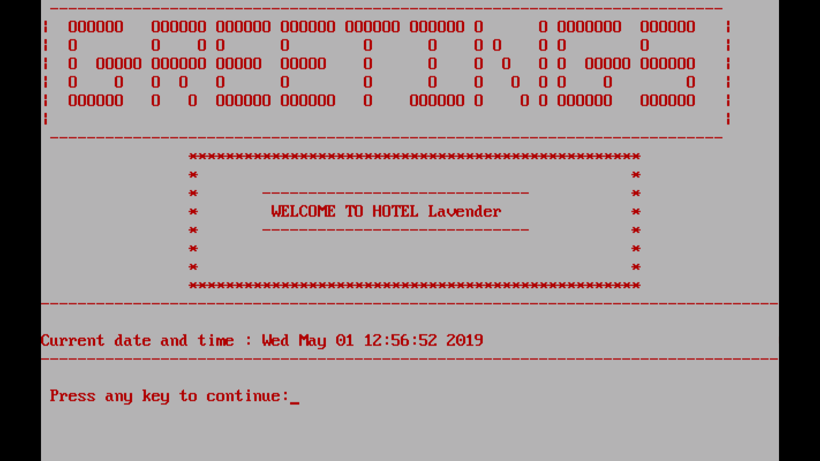
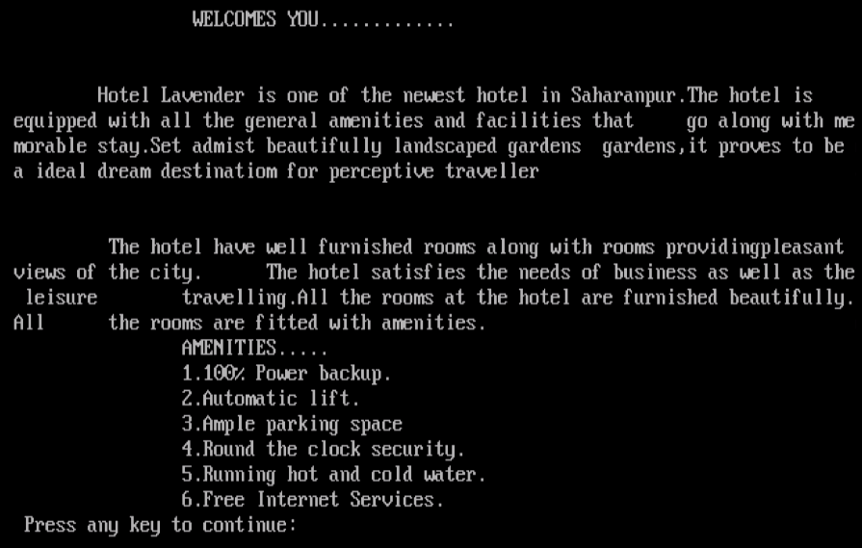
Why hotel management system?
Existing system do not have much flexibility.
In the existing system bills of the customers are calculated manually . Hence increasing the risk of errors.
This new system will do all the processing tasks automatically . Only the prices are needed to be provided .
It will provide more security as the admin should have a valid password to open it .
This system will save time and also the information of the customer can be easily saved and can be easily available at any time .

Slide 10
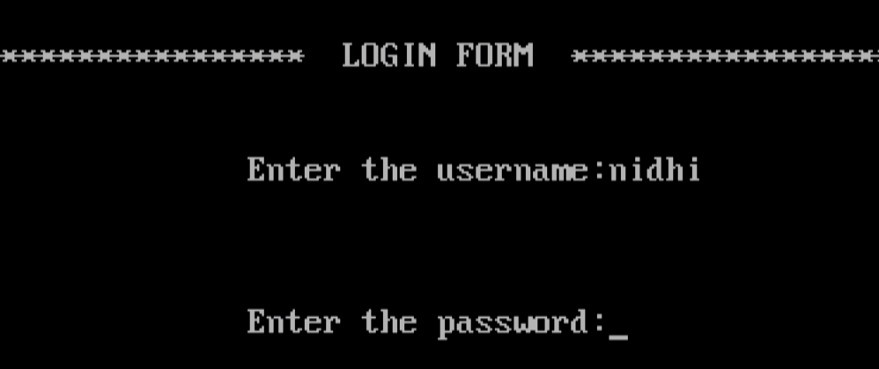
DESCRIPTION
In this system we will be having separate functions for :
Verification of the hotel admin
The hotel manager will be asked to enter the correct username and password. If any one of them is wrong the program will not run. This ensures the security of the program as only the manager will be allowed to access and modify the data of the customer.

Slide 11
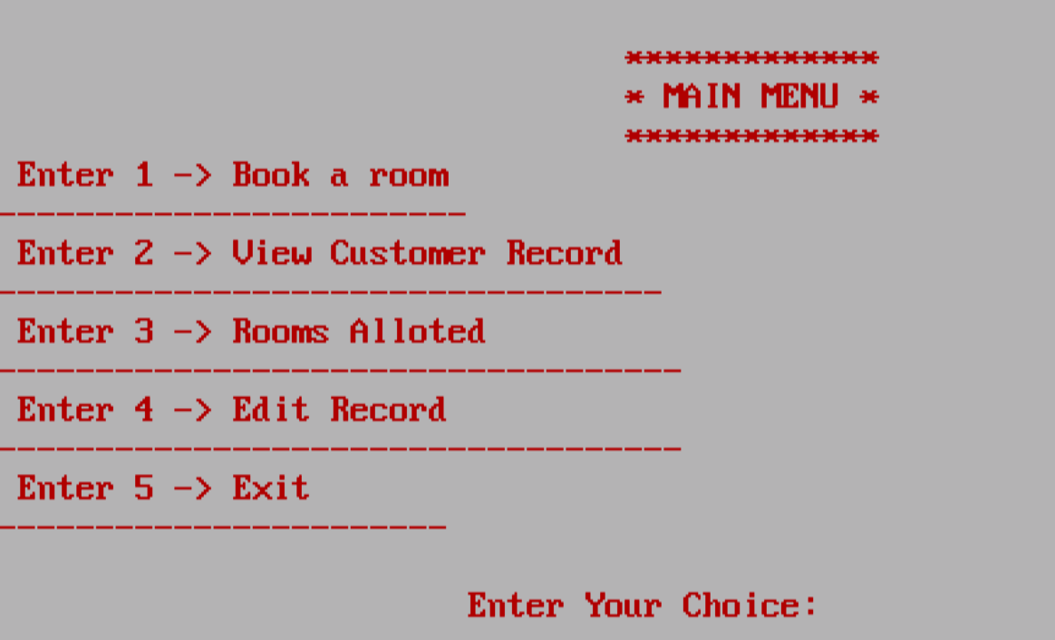
Main menu will be opened
The main menu will be opened.The user will be asked to choose the option. According to the entered option that particular function will be called.The body of that function will be executed .

Slide 12


Checking the availability of room
The user will be asked to enter the room no. the customer desire for.
It will check the availability of room that the room is already booked or not.

Slide 13
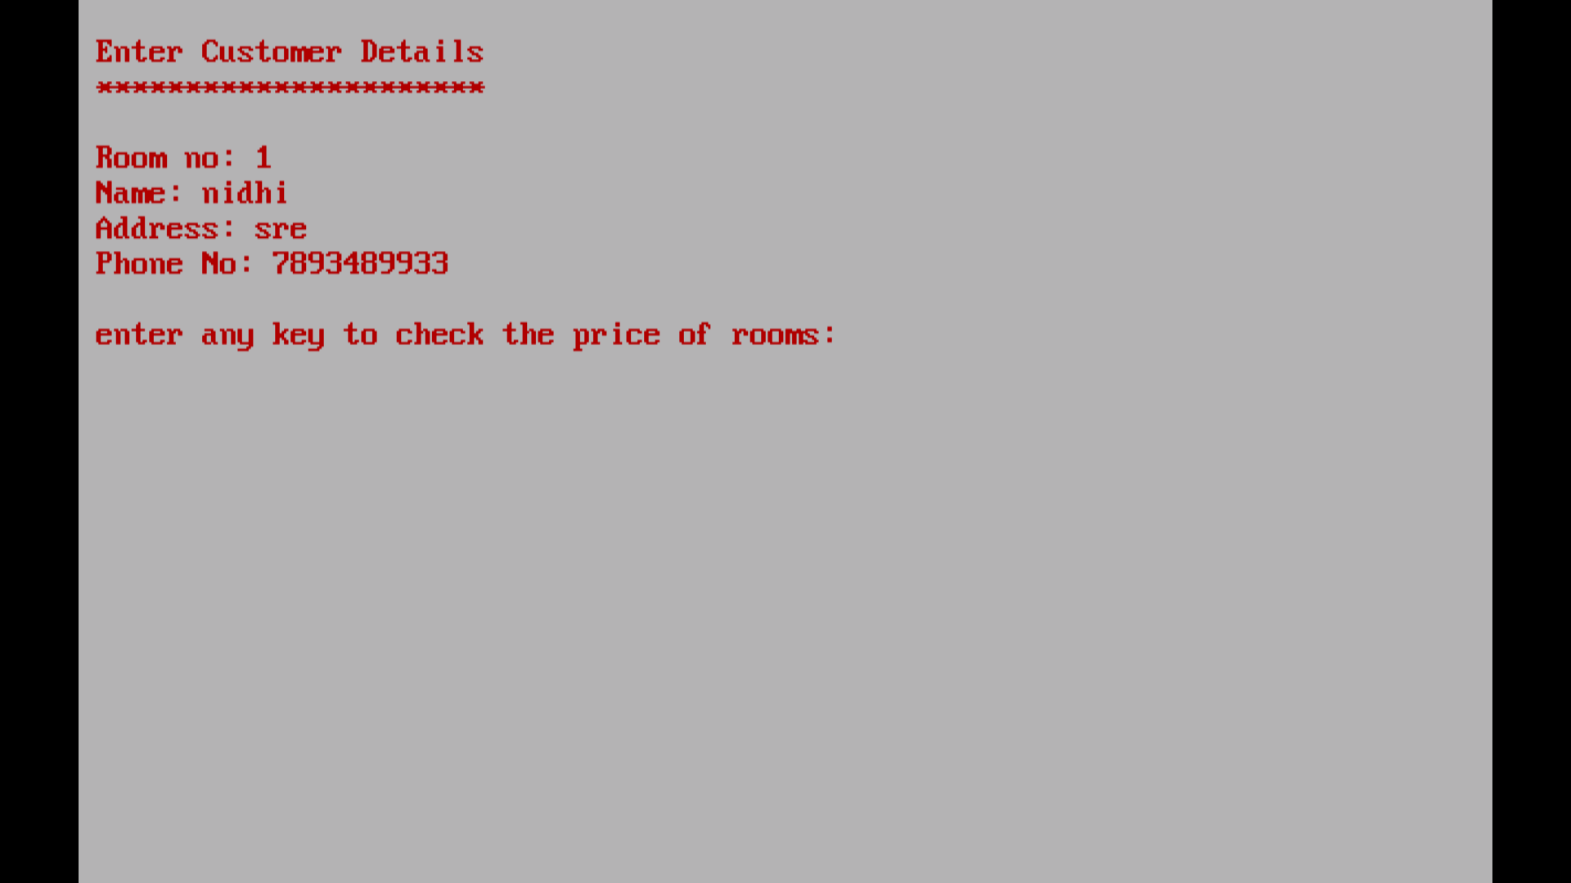
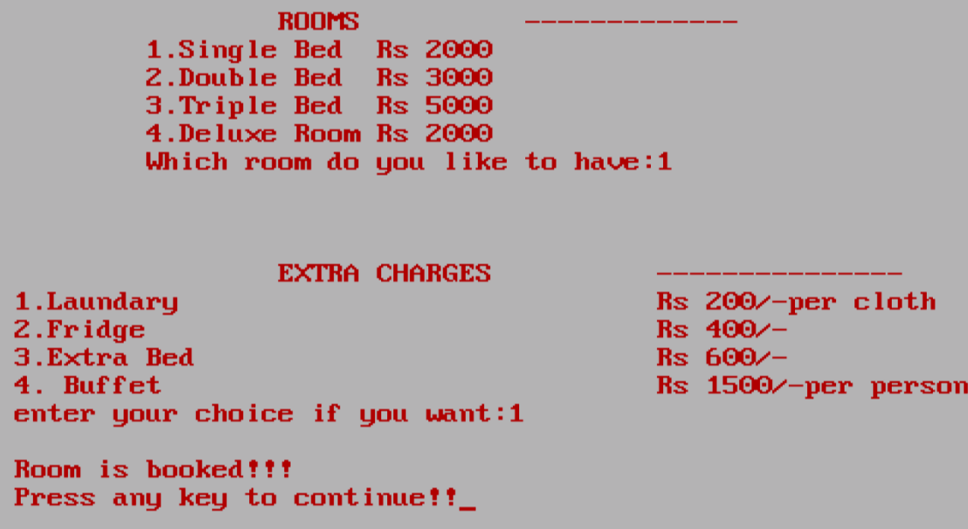
Getting customer information who are lodged in
The important information about the user will be entered.
The prices of the rooms will be shown.
And also the extra charges for extra facilities.

Slide 14
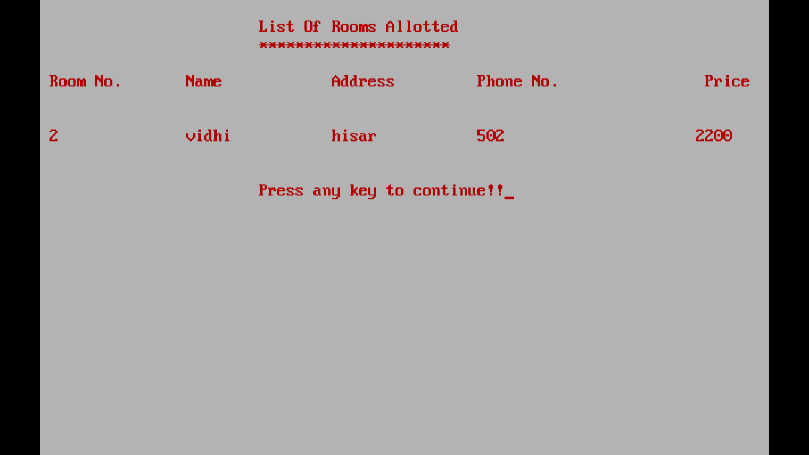

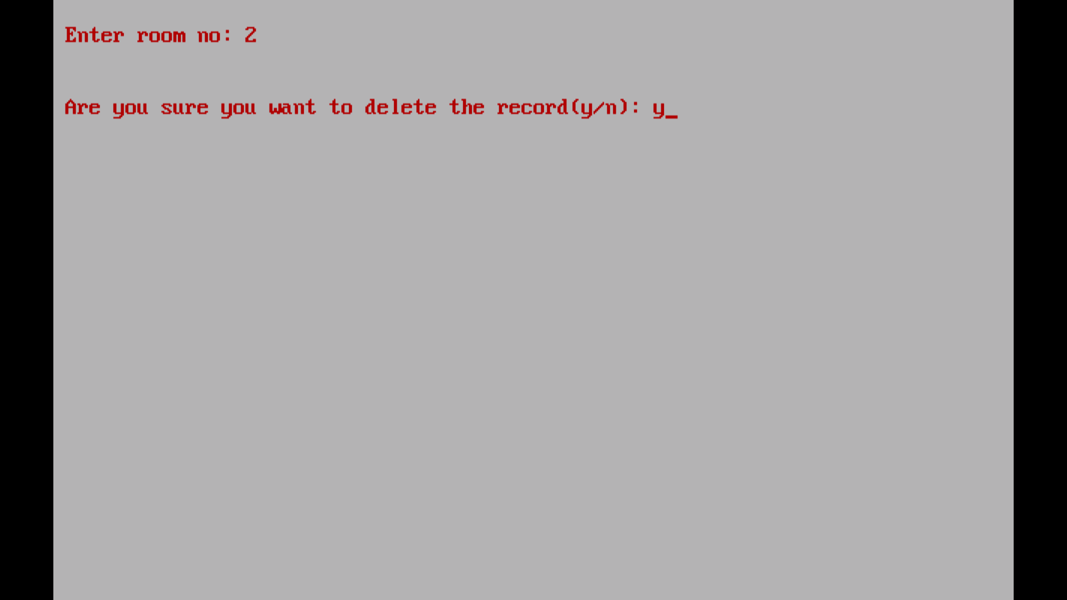
The new information of the customer.
Then the list of rooms of allotted is shown.
The information of the customer can be edited and modified by choosing the option 1 or 2
All these functions are made under the class hotel.
Use of functions ensures the ease in modification in future.

Slide 15
Concepts used:
Classes and objects
If-else conditions
Parametrised and non-parametrised functions
File Handling
Classes and objects: to ensure reusability of code.
If-else conditions : to check the password entered be the admin.
File Handling : to store the information of the customers.
File Handling- This concept is used for storing the data permanently and by using file handling we can store our data in secondary memory(Hard disk).
Parametrised and non-parametrised functions- In our program
we have used some parametrised and non-parametrised functions.

Slide 16
Classes and Objects
Classes
A class in C++ is a user defined type or data structure declared with keyword class that has data and functions (also called methods) as its members whose access is governed by the three access specifiers private, protected or public (by default access to members of a class is private). Objects:
C++ Classes and Objects. The main purpose of C++ programming is to add object orientation to the C programming language and classes are the central feature of C++ that supports object
oriented programming and are often called user-defined types.
2.1.3 Member Function
Member functions are the functions that are the members of the class and can access the data members of the class. No other function can access.

Slide 17
Data members
Data members are the variables of the class and stores the data of the class. Only member function can access the data.
if-else statements:
This statement executes one of two alternative statements, according to specified condition.
SYNTAX:
if(condition)
{
Statement(s);
}
else
{
Statement(s);
}
Switch Statement
This statement provides an alternative to if-else-if construct. It is a multiway branching statement. The switch statement uses one or more case labels. If no matches found ,the default block will be executed.

Slide 18
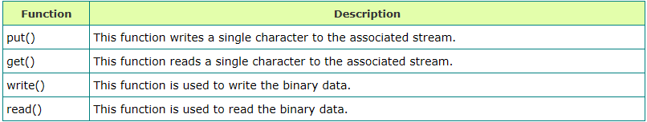
Writing to a File
The insertion operator (<<) is used to write information in a file.
The ofstream or fstream object is used instead of cout object.
Reading from a File
The extraction operator (>>) is used to read information from a file into your program.
The ifstream or fstream object is used instead of cin object.
Following functions are used for I/O Operation:

Slide 19
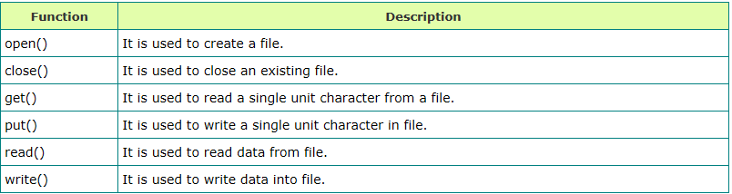
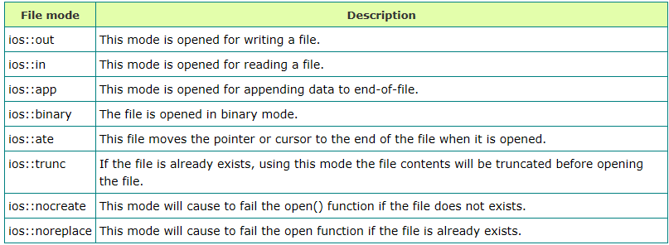
Following are the functions used in File Handling:
Following are the file opening modes:
Closing a File
The close() function is used for closing a file.
Syntax: void close();

Slide 20
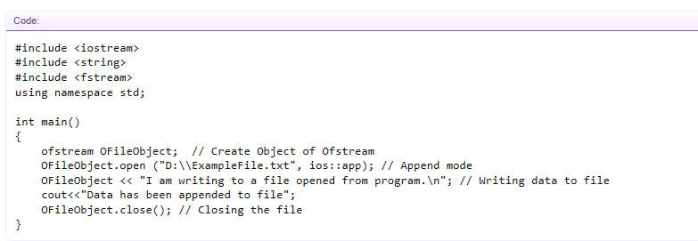
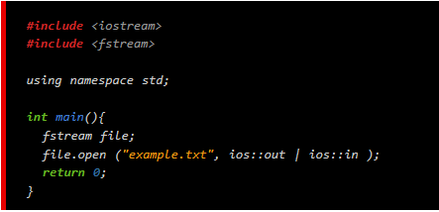
File Handling in different types of mode:
// IN APPEND MODE
// IN READ AND WRITE MODE

Slide 21
BIBLIOGRAPHY
Wikipedia
Computer Science with C++ by Sumita Arora Class-12
Object Oriented Programming by E.Balagurusamy

Slide 22


